Slide 1

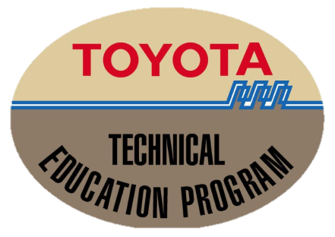
TOYOTA-Technical Education Program
Curriculum Workshop 2014
Technical Training Section

Slide 2
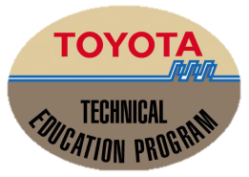
T-TEP Curriculum Workshop 2014
DRIVE TRAIN
BRAKE SYSTEM
STEERING SYSTEM
AIR BAG
Technical Training Section

Slide 3
T-TEP Curriculum Workshop 2014
DRIVE TRAIN
Technical Training Section

Slide 4
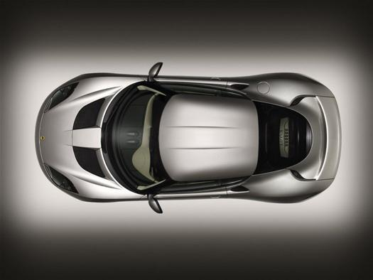
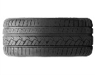
Drive Train
KLASIFIKASI KENDARAAN BERDASARKAN
METODE PENGGERAK
Engine
Transaxel
FF ( Front Engine – Front Drive )
Technical Training Section

Slide 5
Drive Train
KLASIFIKASI KENDARAAN BERDASARKAN
METODE PENGGERAK
Engine
Transmisi
FR ( Front Engine – Rear Drive )
Technical Training Section

Slide 6
Drive Train
KLASIFIKASI KENDARAAN BERDASARKAN
METODE PENGGERAK
Engine
Transmisi
MR ( Midle Engine – Rear Drive )
Technical Training Section

Slide 7
Drive Train
KLASIFIKASI KENDARAAN BERDASARKAN
METODE PENGGERAK
Transfer
Engine
Transmisi
FR ( Front Engine – Front Drive )
Technical Training Section

Slide 8
Drive Train
BAGAIMANA MOBIL
BISA BERGERAK
Technical Training Section

Slide 9
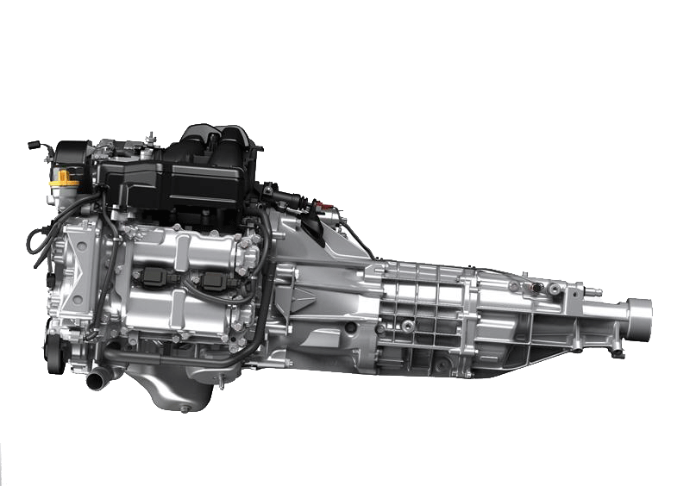
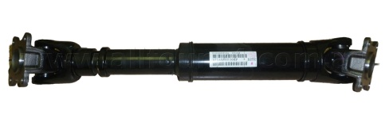
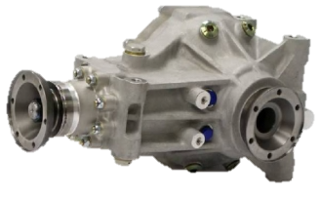
Drive Train
Technical Training Section

Slide 10

Drive Train
Technical Training Section

Slide 11
a
Drive Train
TRANSMISI / TRANSAXEL
MANUAL
AUTOMATIC
Technical Training Section

Slide 12
Drive Train – Sistem Kopling
TRANSMISI / TRANSAXEL
MANUAL
Technical Training Section

Slide 13
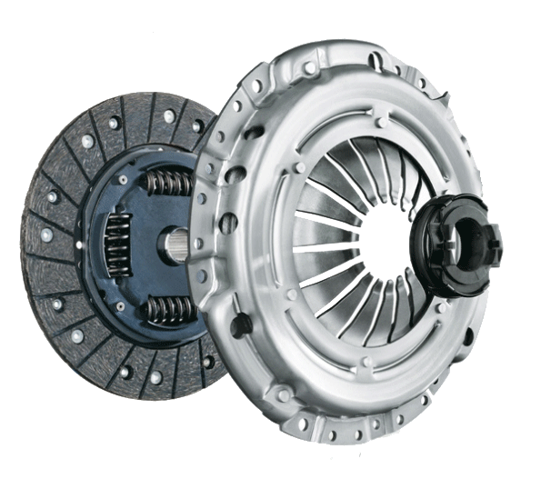
Drive Train
TRANSMISI / TRANSAXEL - MANUAL
Technical Training Section

Slide 14
Drive Train
Drive Train – Sistem Kopling
Untuk melepas dan meneruskan daya dari mesin ke transmisi
Technical Training Section

Slide 15
Drive Train – Transmisi Manual
Sebagai perubah putaran dan tenaga dari mesin menuju ke roda
Pemindahan gigi secara manual (plus injak pedal kopling)
Technical Training Section

Slide 16
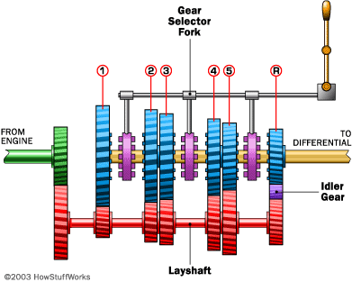
Drive Train ( Transmisi – Manual )
Technical Training Section

Slide 17
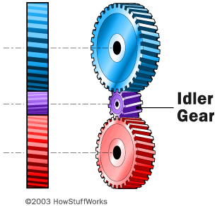
Drive Train ( Transmisi – Manual )
Kecepatan dan Torsi, gigi mundur
Technical Training Section

Slide 18
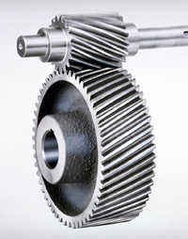
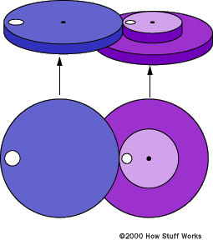
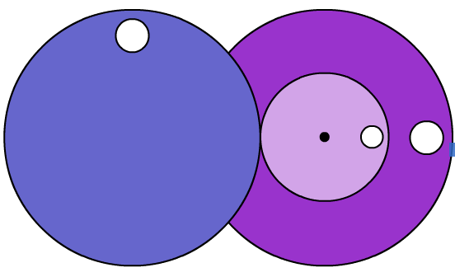
Drive Train ( Transmisi – Manual )
Gear Ratio
Technical Training Section

Slide 19
Drive Train – Transmisi Automatic
TRANSMISI / TRANSAXEL
AUTOMATIC
Technical Training Section

Slide 20
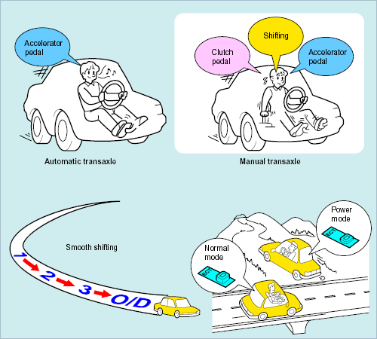
Drive Train ( Transmisi – Automatic )
Sebagai perubah putaran dan tenaga dari mesin menuju ke roda
Pemindahan gigi secara otomatis (posisi D: 1-2-3-4)
Technical Training Section

Slide 21
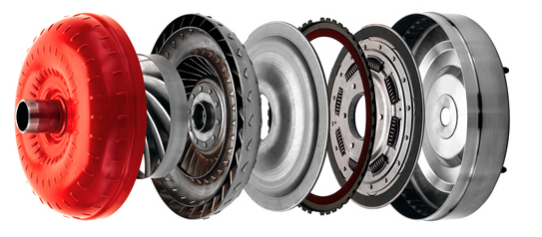
Drive Train ( Transmisi – Automatic )
Prinsip kerja Torque Converter
Technical Training Section

Slide 22
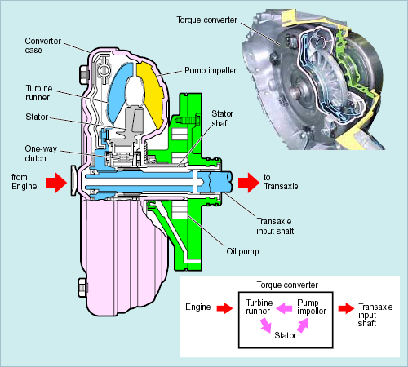
Drive Train ( Transmisi – Automatic )
Torque Converter
Sebagai kopling otomatis
Meredam getaran
Melipat gandakan momen
Sebagai flywheel
Penggerak pompa oli tansmisi otomatis
Technical Training Section

Slide 23
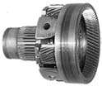


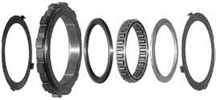


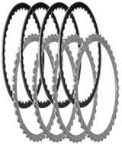
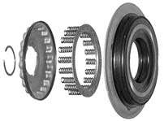
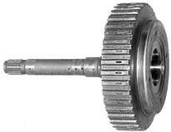
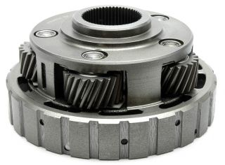
Drive Train ( Transmisi – Automatic )
Planetary Gear Unit
- Menghasilkan gear ratio percepatan dan perlambatan
Merubah arah putaran
Menghasilkan posisi Netral

Slide 24
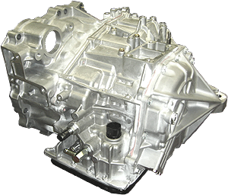
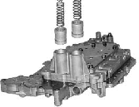
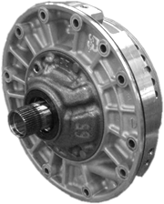

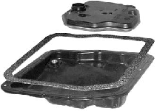
Drive Train ( Transmisi – Automatic )
Hydraulic control unit Unit
- Mengatur pelumasan komponen planetary gear unit
- Mengatur tekanan line pressure untuk mengaktifkan
Clutch & Brake pada PGU berdasarkan sinyal dari ECU
Oil Pump
Valve body dan solenoid

Slide 25
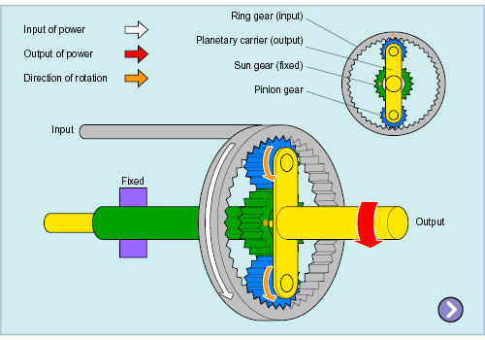
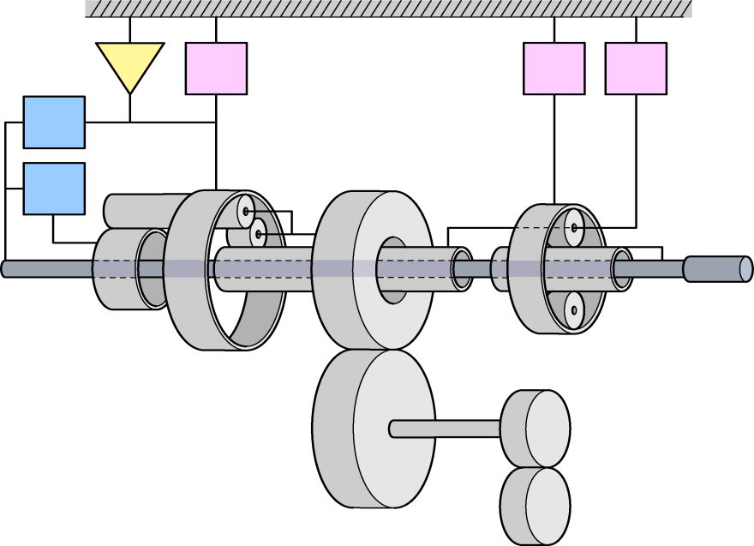
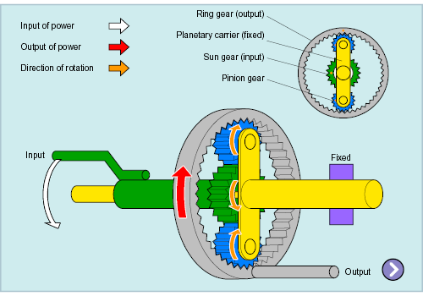
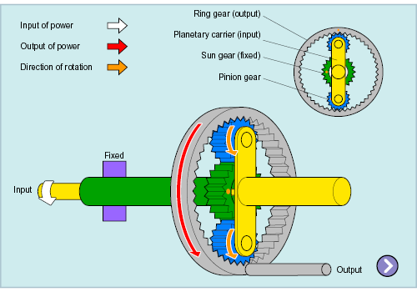
Drive Train ( Transmisi – Automatic )
Deselerasi
Planetary Gear Unit
F1
B2
B3
B1
C2
C1
Akselerasi
Mundur
Technical Training Section

Slide 26
Drive Train – Transmisi CVT
Continuously
Variable
Transmission
Technical Training Section

Slide 27
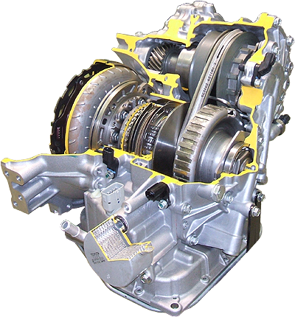
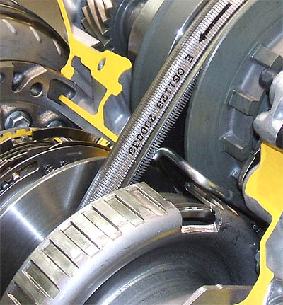
CVT – ( Continuously Variable Transmission
Forward and Reverse Drive Shift Mechanism
Secondary Pulley
Torque Converter with Lock-up Clutch
Metal Belt
Primary Pulley
CVT Fluid Warmer
Technical Training Section

Slide 28
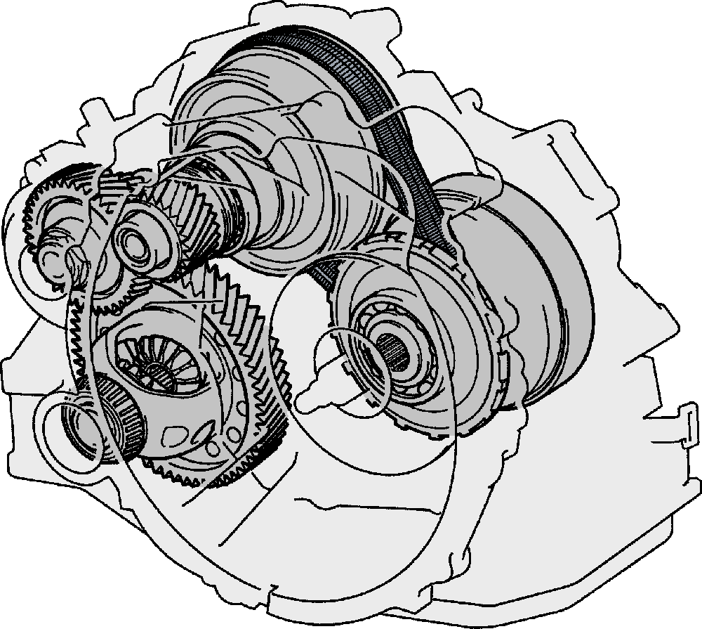
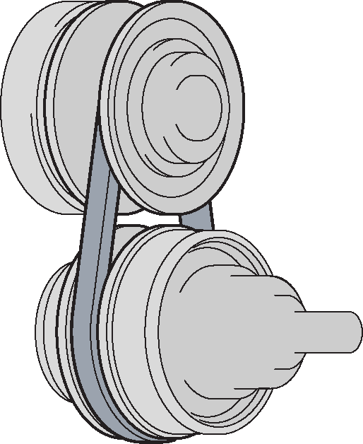
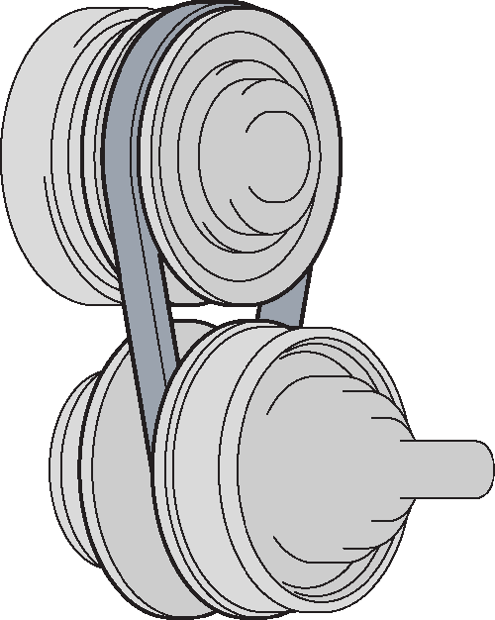
CVT – ( Continuously Variable Transmission
Features of CVT
  CVT perform speed ratio control using a pair of pulleys
Secondary Pulley
Pulley Width = Large
Pulley Width = Small
Metal Belt
Primary Pulley
INPUT
OUTPUT
Pulley Width = Small
Pulley Width = Large
High Speed Ratio
Low Speed Ratio
Operation of CVT
Technical Training Section

Slide 29


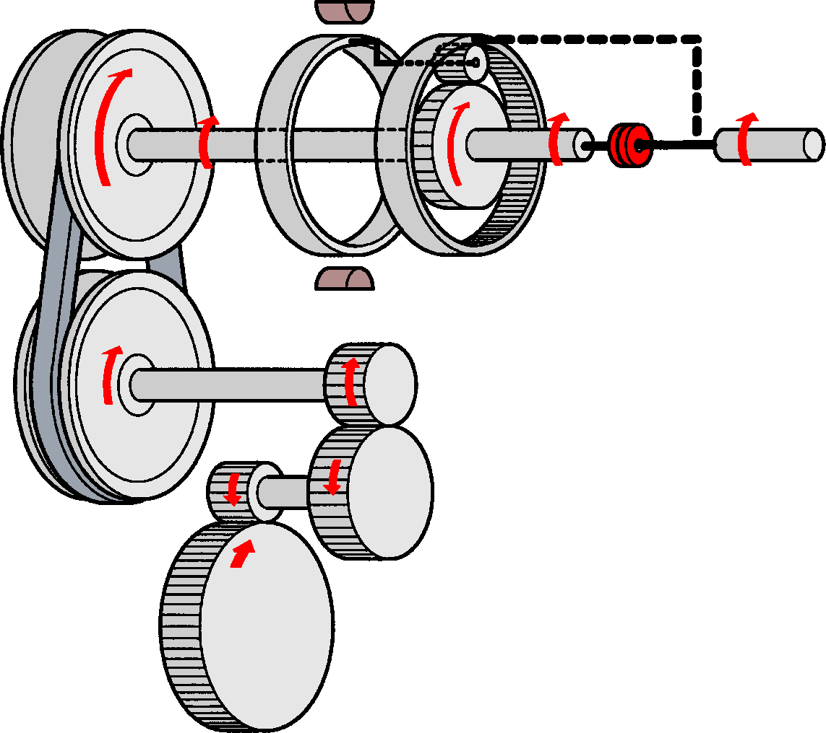
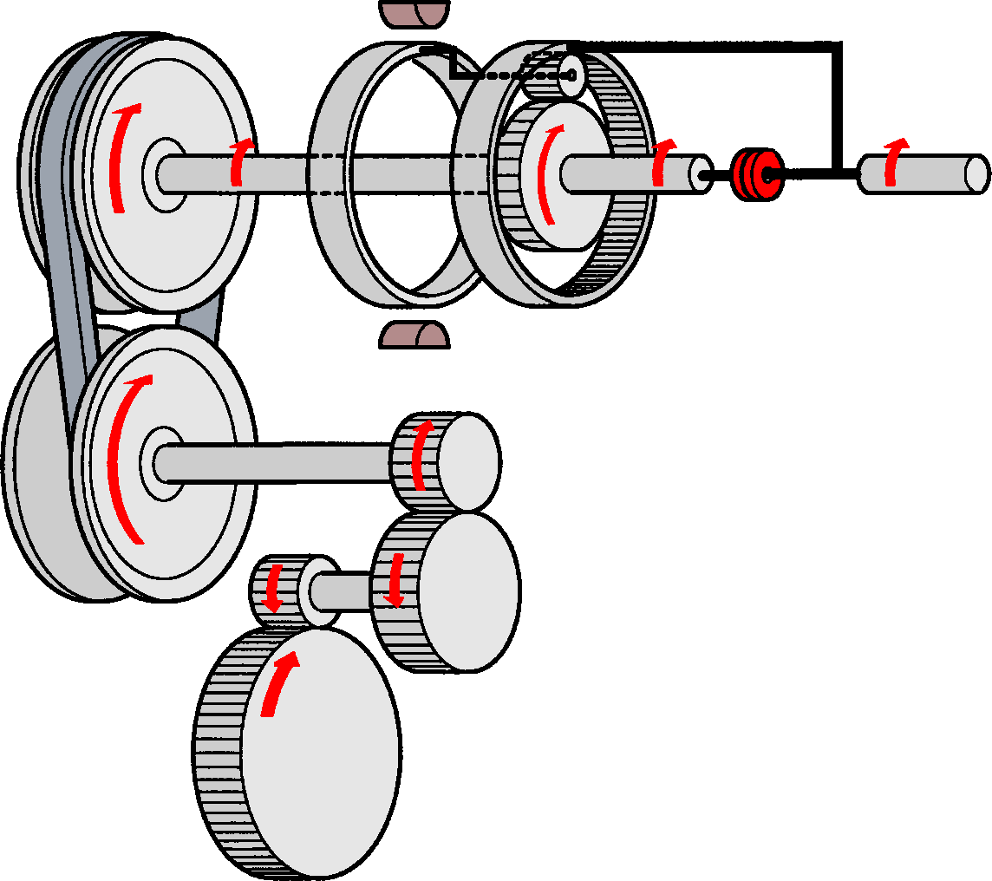
CVT – ( Continuously Variable Transmission
Gear Train Operation (D Position)
D position
(Lowest Ratio)
D position
(Highest Ratio)
Pulley Width = Large
Pulley Width = Small
OFF
OFF
ON
ON
ON
Pulley Width = Small
Pulley Width = Large
Technical Training Section

Slide 30

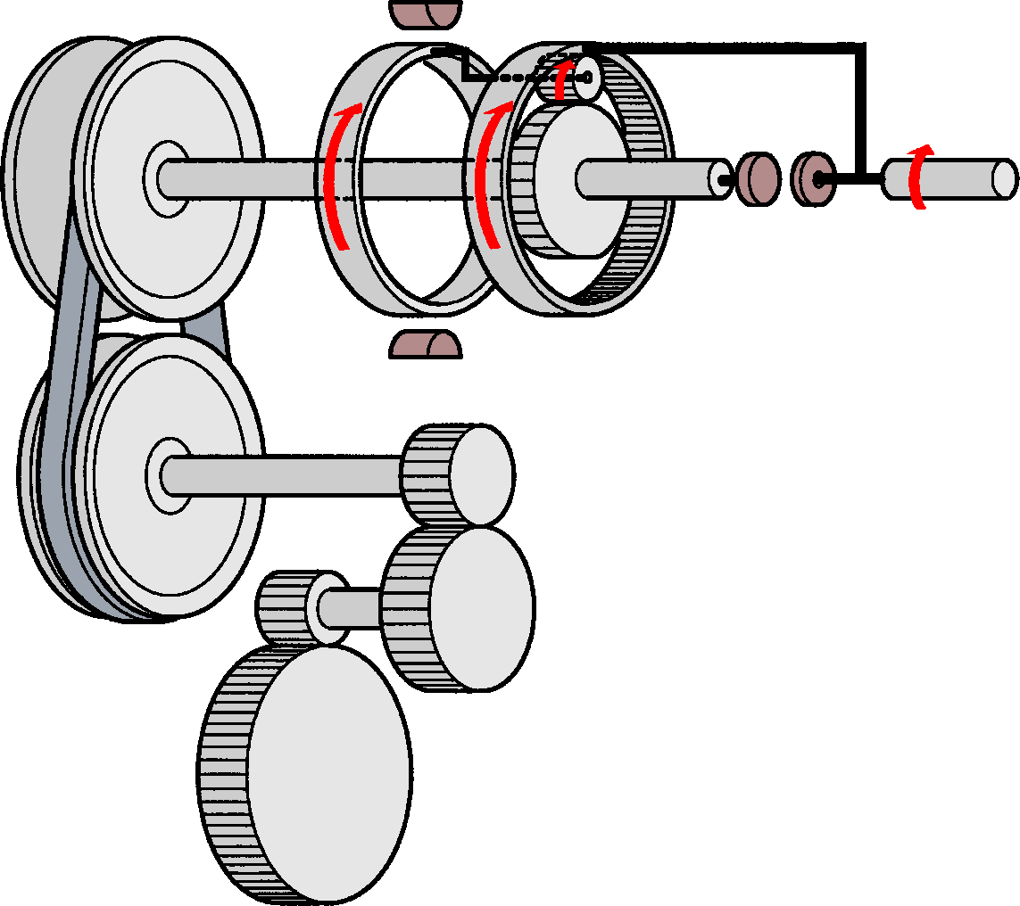
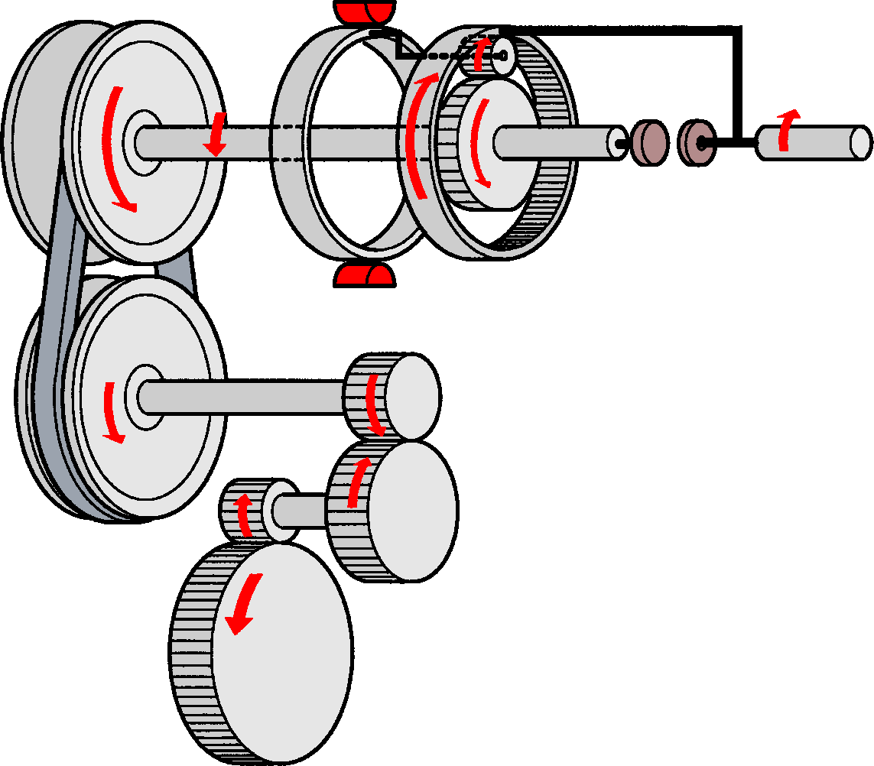
CVT – ( Continuously Variable Transmission
Gear Train Operation (N and R Position)
N position
R position
Pulley Width = Large
Pulley Width = Large
OFF
ON
OFF
OFF
Pulley Width = Small
Pulley Width = Small
Technical Training Section

Slide 31
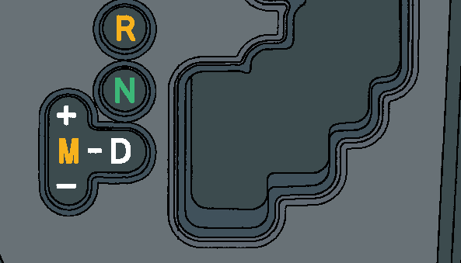
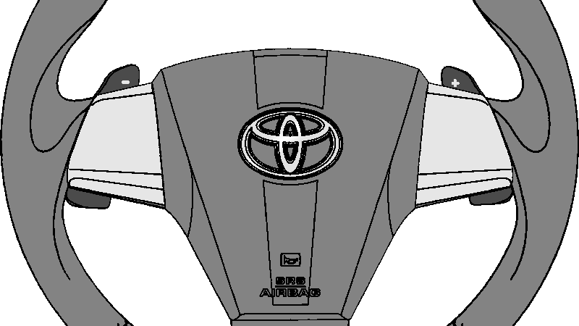
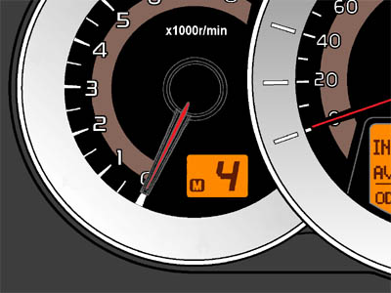




CVT ( Continously Variable Transmission )
Sport Sequential Shiftmatic
  Speed ratio dirubah dengan mengatur shift lever pada posisi "+" or "-" atau menarik tuas paddle switch
-
+
Shift Position Indicator
Vehicle stopped

Slide 32
Drive Train ( Brake System )
BRAKE SYSTEM
Technical Training Section

Slide 33
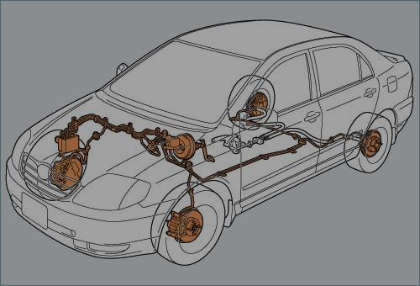
Drive Train ( Brake System )
Technical Training Section

Slide 34
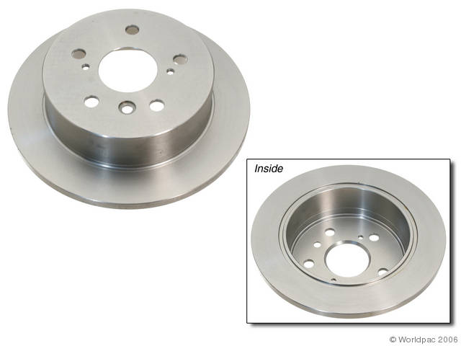
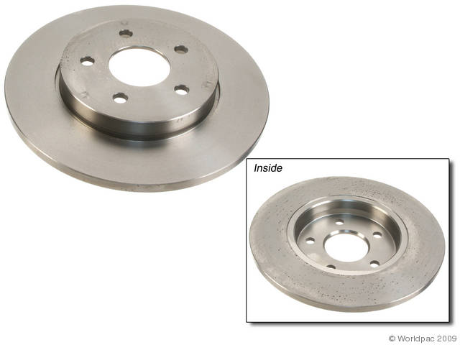
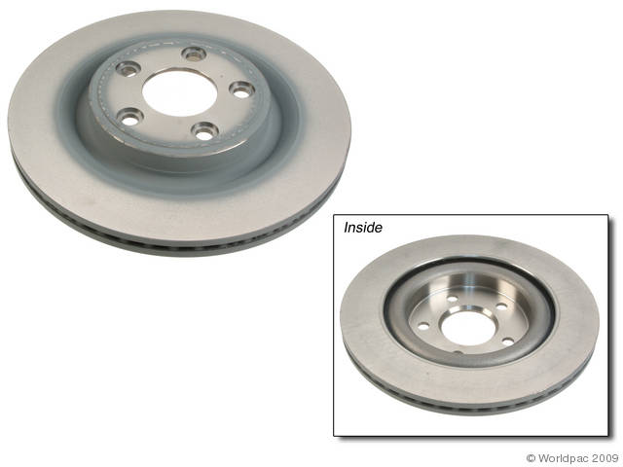
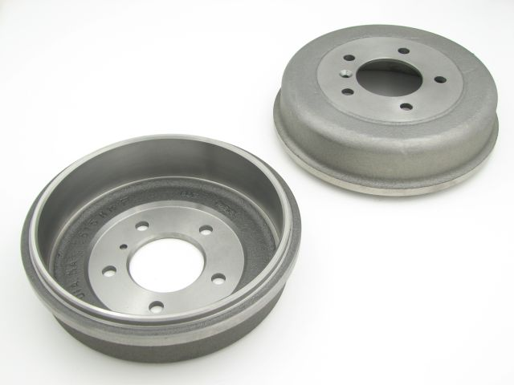
Drive Train ( Brake System )
Rem
Tipe - Tipe Rem
1.Rem Cakram ( Disc Brake)
1.Rem Cakram ( Disc Brake)
2.Rem Tromol ( Drum Brake)
2.Rem Tromol ( Drum Brake)
Notes:
Komponen-komponen rem manual.

Slide 35
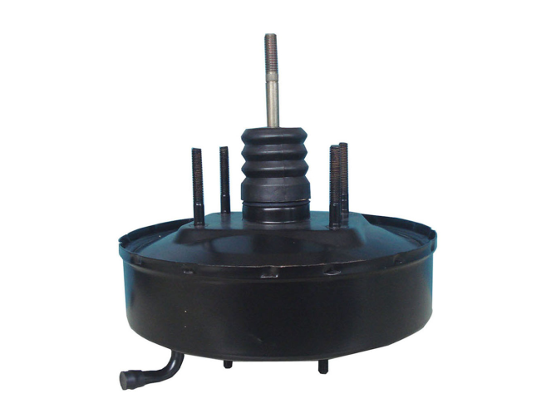
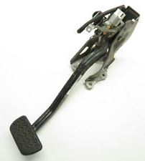
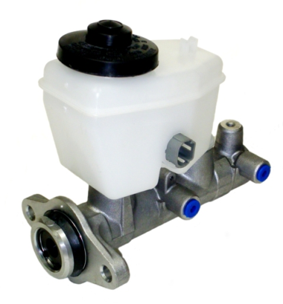




Komponen Utama
Brake Pedal
Brake Booster
Brake Master Cylinder
Caliper
Wheel Cylinder

Slide 36


Komponen Utama
Brake Pad (untuk disc brake)
Brake Shoe (untuk drum brake)

Slide 37

Drive Train ( Brake System )
Rem Tromol dan Disc
Animasi film
Notes:
Cara kerja rem (aliran minyak rem)
Jenis Rem:
Disc Brake
Tromol/Drum

Slide 38

Drive Train ( Brake System )
Cara Kerja Rem Cakram

Slide 39

Drive Train ( Brake System )

Slide 40
Drive Train ( Brake System )
ABS ( Antilock Brake System)
EBD ( Electronic Brake Force Distribution )
BA ( Brake Assist )
TRC ( Traction Control )
VSC ( Vehicle Stability Control )

Slide 41

Drive Train ( Antilock Brake System )
Komponen
Anti-Lock Brake System

Slide 42


ABS ( Anti-lock Braking System )
Garis Besar
Injak dan tahan pedal rem dengan kuat.
Jangan memompa pedal rem
Pedal rem bergetar dan berbunyi adalah ciri-ciri ABS sedang bekerja.
ABS bertujuan agar roda-roda tidak mengunci ketika dilakukan pengereman sehingga kendaraan tetap dapat dikendalikan arahnya dan jarak pengereman tetap terjaga.
Click movie

Slide 43




EBD ( Electronic Brakeforce Distribution)
Garis Besar
mengatur distribusi kekuatan rem ke setiap roda
sesuai distribusi beban pada kendaraan

Slide 44

Drive Train ( Electronic Brake Force Distribution )
EBD

Slide 45

Drive Train ( Brake Assist System )
BA, Brake Assist

Slide 46



BA ( Brake Assist )
Garis Besar
Quickly
10 m
Dengan BA
18 m
Tanpa BA
Jarak Pengereman

Slide 47

TRC (Traction Control)
memastikan stabilitas pengendaraan dengan cara mencegah agar roda-roda penggerak tidak slip seperti saat kendaraan mulai bergerak.

Slide 48

( VSC ) Vehicle Stability Control*
Memastikan kestabilan kendaraan saat kendaraan menjadi tidak stabil selama membelok.
with VSC
without VSC
Understeer
Roda Depan Slip
Oversteer
Roda Belakang Slip

Slide 49

Drive Train ( Vehicle Stability Control )
Vehicle Stability Control
Click Movie

Slide 50
a
Drive Train
STEERING SYSTEM
Technical Training Section

Slide 51



Technical Training Section

Slide 52

Mekanisme Kemudi Rack and Pinion

Slide 53


Mekanisme Kemudi Recirculating Ball

Slide 54

Power Steering
Technical Training Section

Slide 55

Power Steering
Technical Training Section

Slide 56

Prinsip Kerja Power Steering
Technical Training Section

Slide 57


Jenis-jenis Power Steering
Konvensional / Hidrolis
Electric Power Steering

Slide 58



Electric Power Steering
Power Steering ECU
EPS Warning Light
Steering Column Assembly
Torque Sensor
DC Motor
Reduction Mechanism
Power
Steering
ECU
Electric
motor
Power Steering Torque Flow Chart
Steering
rack
Steering
column
Driver
input
Steering Rack
Assembly

Slide 59

a
Drive Train
AIR BAG
Technical Training Section

Slide 60

Komponen

Slide 61

Supplemental Restraint System, Tipe Air Bag
Dual-stage
Front Airbags
Knee Airbag
(Driver’s Seat Only)
Side Airbags Size Up
Curtain Shield Airbag
Notes:
Jenis Airbag

Slide 62


Supplemental Restraint System, Air Bag
Pelindung penumpang saat terjadi tabrakan
84
Notes:
Supplemental Restrain System, merupakan sistem tambahan keselamatan sebagai penambah untuk sistem Seatbelt.
(yang utama tetap Seatbelt).
Gambar kiri:
Proses tabrakan sampai berhenti (50 km/jam) memerlukan waktu ~0,2 detik.
Dan kecepatan badan penumpang saat menabrak dashboard/kaca sama seperti ketika jatuh dari gedung lt. 3.
Oleh karena itu, airbag dirancang untuk mengembang dan kempes (untuk meredam laju penumpang) sekitar 0,2 detik.
Kecepatan air bag mengembang sekitar 300 km/jam.
Gambar kanan:
Airbag bekerja berdasarkan front airbag sensor dan (bukan atau) center airbag sensor assembly.
Lalu center airbag sensor assembly akan mengirim arus ke ke Airbag pengemudi dan penumpang untuk menyalakan gas inflator.
Gas akan terbakar dan membuat kantong airbag mengembang (menyobek kulit permukaan steer/dashboard)
Airbag akan kempes karena tekanan gas ditambah tumbukan kepala pengemudi/penumpang depan.
Sehingga kecepatan wajah penumpang akan berkurang saat mengenai steer atau dashboard.

Slide 63

Video Supplemental Restraint System, Air Bag Depan
84

Slide 64

Video Supplemental Restraint System, Air Bag Curtain-Shield
84

Slide 65



Range Sensor Depan
Supplemental Restraint System
- Airbag tidak mengembang
Airbag Depan
Airbag Samping & Curtain
Notes:
Airbag tidak mengembang jika:
Airbag Depan (pengemudi & penumpang)
Ditabrak dari belakang
Ditabrak dari samping
Berguling
Menabrak lubang jalan
Kendaraan loncat
Airbag samping & Shield Curtain
Ditabrak dari belakang
Tabrakan depan
Berguling
Range sensor airbag depan adalah 15 derajat kiri & kanan. Jika sudut tabrakan lebih dari itu, airbag tidak mengembang.

Slide 66
a
Drive Train
TERIMA KASIH
Technical Training Section

