Slide 1



Hybrid
TTEP Curriculum Workshop
2014
Kemendikbud - Toyota Training Center
Restricted to TTEP only
Copyright © PT. Toyota-Astra Motor

Slide 2
Hybrid
1. Tipe Sistem Hybrid
2. Cara Kerja TOYOTA Hybrid System
3. Perbaikan Sistem Hybrid
4. Komponen Utama TOYOTA Hybrid System
Restricted to TTEP only
Copyright © PT. Toyota-Astra Motor

Slide 3
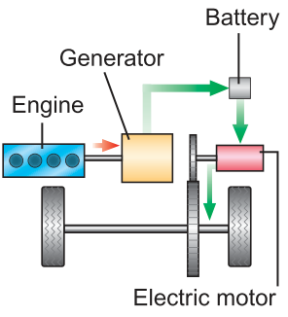
Tipe Sistem Hybrid
SERIES HYBRID
Motor bensin memutarkan generator untuk mensuplai listrik ke motor listrik penggerak roda
Contoh: Chevrolet Volt
Restricted to TTEP only
Copyright © PT. Toyota-Astra Motor

Slide 4
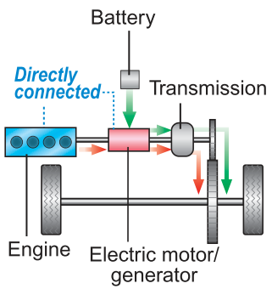

Tipe Sistem Hybrid
PARALEL HYBRID
Motor bensin sebagai penggerak roda utama, motor listrik hanya membantu akselerasi
Contoh: Honda Insight, MB S400 BlueHybrid, BMW Seri 7 Hybrid
Engine
Motor
Restricted to TTEP only
Copyright © PT. Toyota-Astra Motor

Slide 5
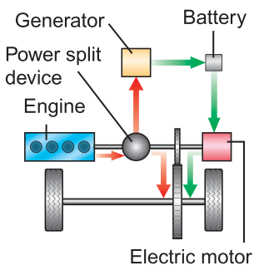

Tipe Sistem Hybrid
SERIES AND PARALEL HYBRID
“Power split device” secara konstan mengatur rasio tenaga motor bensin / listrik ke roda. Dapat menggerakkan kendaraan hanya dengan motor listrik saja.
Contoh: TOYOTA Hybrid System
Engine
Motor
Restricted to TTEP only
Copyright © PT. Toyota-Astra Motor

Slide 6
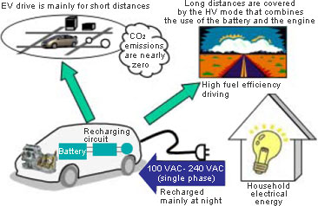
Tipe Sistem Hybrid
PLUG IN HYBRID
Baterai dengan kapasitas lebih besar (biasanya Lithium) dapat di charge dengan listrik “rumah” untuk memperbanyak penggunaan motor listrik dan mengurangi penggunaan motor bensin.
Contoh: Sampai akhir 2009, Prius Plug-in akan di leasing 500 unit di Jepang, US & Eropa
Restricted to TTEP only
Copyright © PT. Toyota-Astra Motor

Slide 7
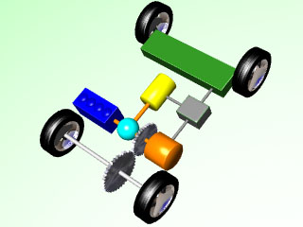
Cara Kerja TOYOTA Hybrid System
Mobil Berhenti
Mulai Jalan, Beban Ringan,
Mundur
Pengendaraan
Normal
Pengendaraan dengan beban
berat/
percepatan
Perlambatan
Kendaraan Berhenti
(Pengisian Batere)
Restricted to TTEP only
Copyright © PT. Toyota-Astra Motor

Slide 8

Cara Kerja TOYOTA Hybrid System
Engine Starting and Idling
Vehicle Speed
Click!
Animasi
Click!
Movie
Restricted to TTEP only
Copyright © PT. Toyota-Astra Motor

Slide 9

Cara Kerja TOYOTA Hybrid System
Vehicle Starting Off
Vehicle Speed
Click!
Animasi
Click!
Movie
Restricted to TTEP only
Copyright © PT. Toyota-Astra Motor

Slide 10
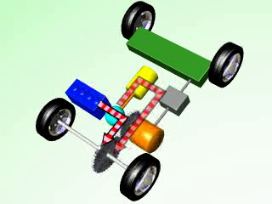
Cara Kerja TOYOTA Hybrid System
Accelerating Under Low Load (Light Throttle)
Vehicle Speed
Click!
Animasi
Click!
Movie
Restricted to TTEP only
Copyright © PT. Toyota-Astra Motor

Slide 11

Cara Kerja TOYOTA Hybrid System
Accelerating Under Heavy Load (Full Throttle)
Vehicle Speed
Click!
Animasi
Click!
Movie
Restricted to TTEP only
Copyright © PT. Toyota-Astra Motor

Slide 12
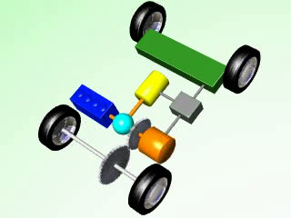
Cara Kerja TOYOTA Hybrid System
Decelerating
Vehicle Speed
Click!
Animasi
Click!
Movie
Restricted to TTEP only
Copyright © PT. Toyota-Astra Motor

Slide 13

Cara Kerja TOYOTA Hybrid System
Driving in Reverse
Vehicle Speed
Click!
Animasi
Click!
Movie
Restricted to TTEP only
Copyright © PT. Toyota-Astra Motor

Slide 14
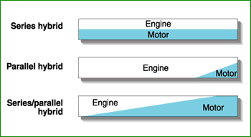
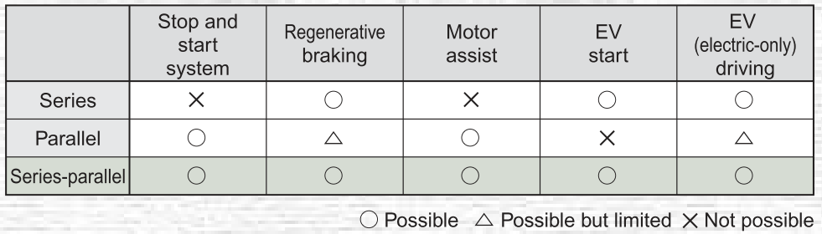
Perbandingan Sistem Hybrid
Restricted to TTEP only
Copyright © PT. Toyota-Astra Motor

Slide 15
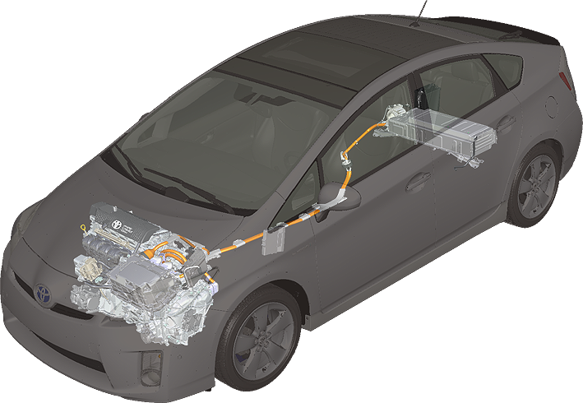
Komponen Utama TOYOTA Hybrid System
Auxiliary Battery
(Sealed Type)
HV Battery Unit
Battery Module
(DC 201.6 V)
Junction Block
Battery Smart Unit
2ZR-FXE Engine
Cooler Compressor with Motor Assembly
Power Cable
Power Management Control ECU (HV CPU)
Inverter with Converter Assembly
Boost Converter • Inverter
MG ECU
DC/DC Converter
for Auxiliary Battery
ECM
Restricted to TTEP only
Copyright © PT. Toyota-Astra Motor
P410 Hybrid Transaxle
MG1 • MG2

Slide 16
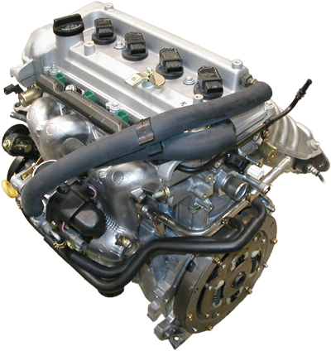
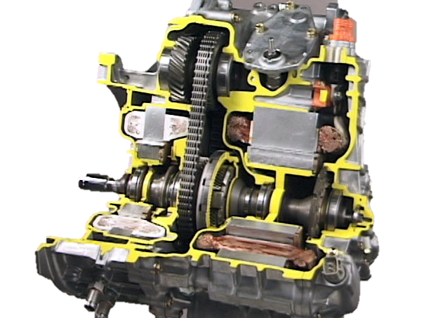
Komponen Utama TOYOTA Hybrid System
MG1
MG2
Restricted to TTEP only
Copyright © PT. Toyota-Astra Motor
Gasoline Engine with Atkinson Cycle
Hybrid Transaxle

Slide 17
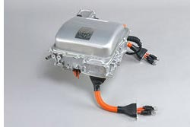
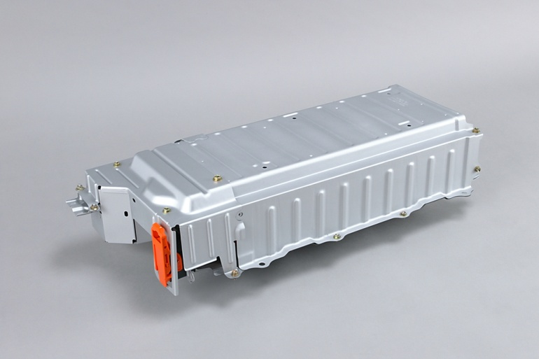
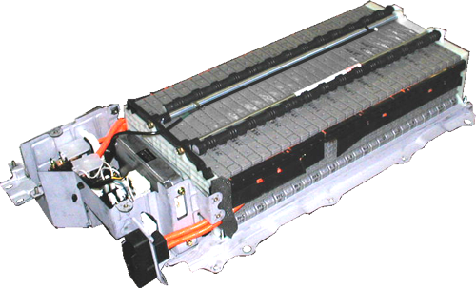
Komponen Utama TOYOTA Hybrid System
Power Control terdiri dari inverter yang merubah arus DC dari baterai menjadi AC untuk memutar motor dan DC/DC converter untuk merubah jadi 12V DC.
Pada THS II, high-voltage power circuit dapat menaikkan tegangan dari power supply menjadi AC 650 V (3rd Gen Prius)
Baterai terbuat dari Nickel-Metal Hydride (201.6V)
’04 & ’09 PRIUS: 168 cell ((1.2V x 6 cells) x 28 modules) = DC 201.6 V
Restricted to TTEP only
Copyright © PT. Toyota-Astra Motor

Slide 18
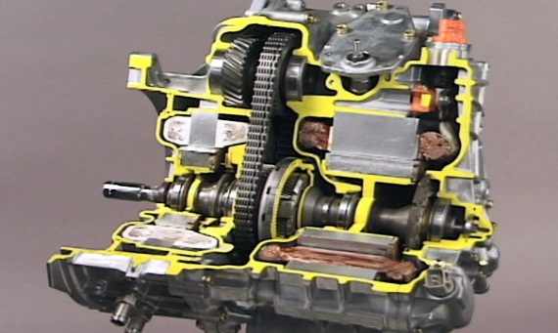
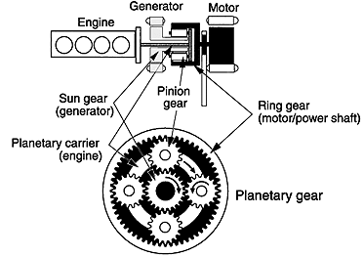
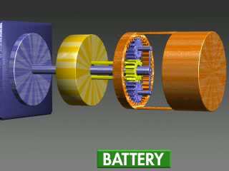
Komponen Utama TOYOTA Hybrid System
Hybrid Transaxle
Blue: Engine
Yellow: MG1
Orange: MG2
Click, movie
Restricted to TTEP only
Copyright © PT. Toyota-Astra Motor

Slide 19
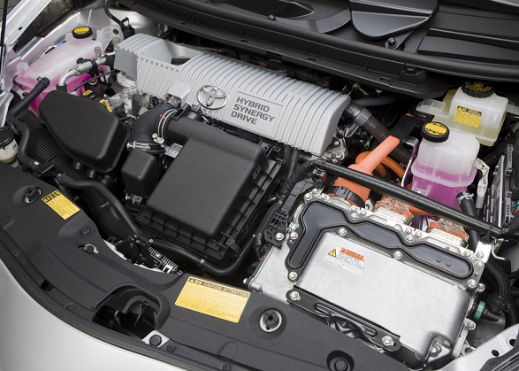
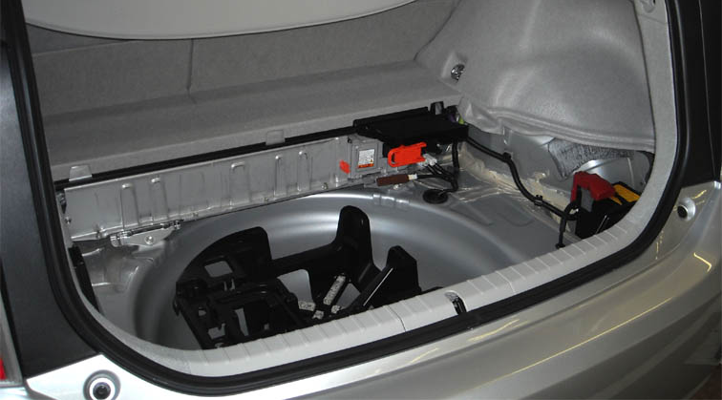
Komponen Utama TOYOTA Hybrid System
HV Battery
12V Battery
Engine
Inverter/Converter
High Voltage Cables: Orange Color
Restricted to TTEP only
Copyright © PT. Toyota-Astra Motor

Slide 20
Restricted to TTEP only
Copyright © PT. Toyota-Astra Motor

